Slide 1

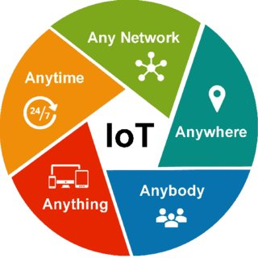
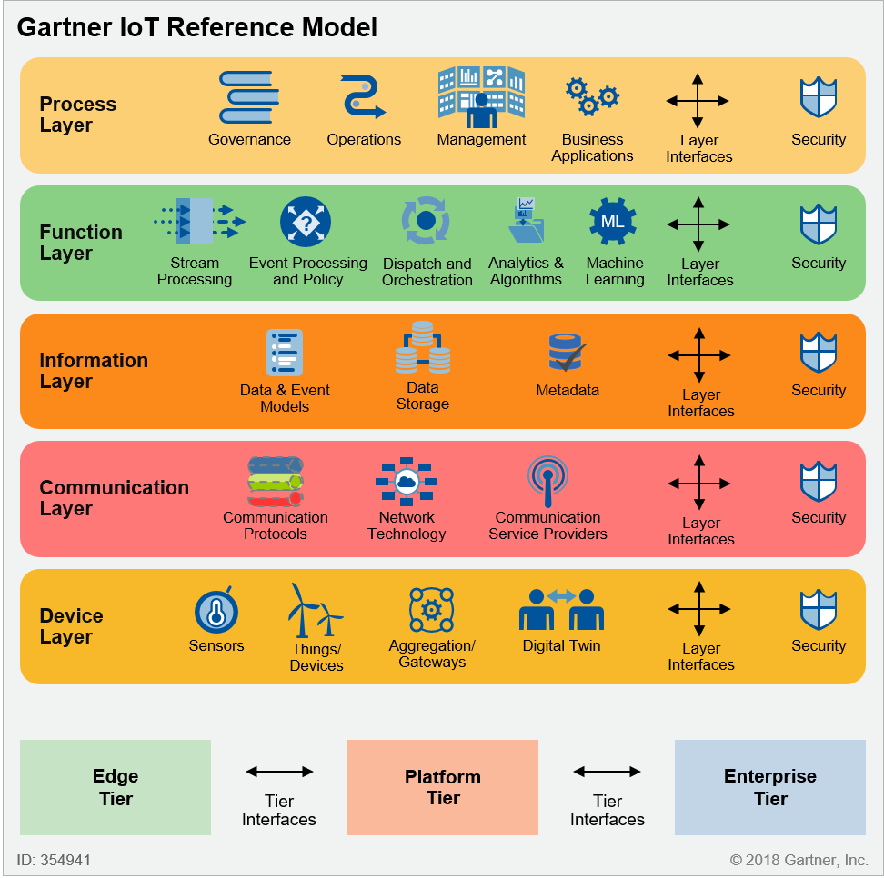
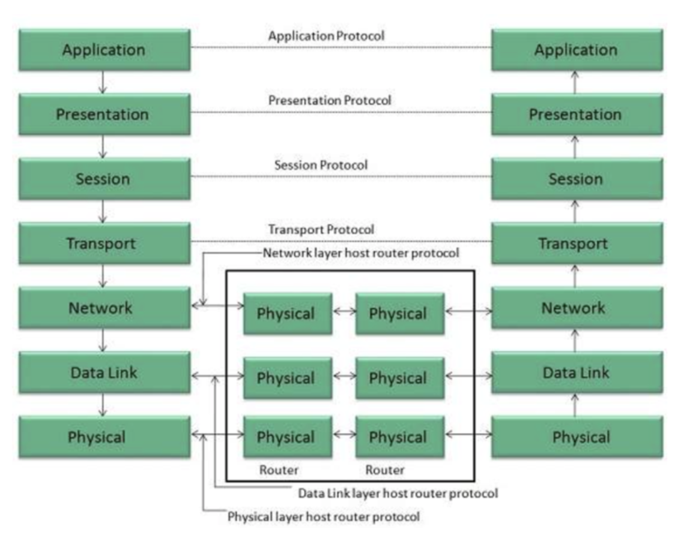
Communication models in IoT
Understanding the Backbone of IoT Connectivity
1

Slide 2
What is IoT?
The Internet of Things (IoT) is a network of interconnected devices that can collect, share, and act on data through the internet without requiring human-to-human or human-to-computer interaction.
2

Slide 3
Role of Communication Models in IoT
Communication models define how IoT devices interact with each other, gateways, and cloud systems.
3

Slide 4
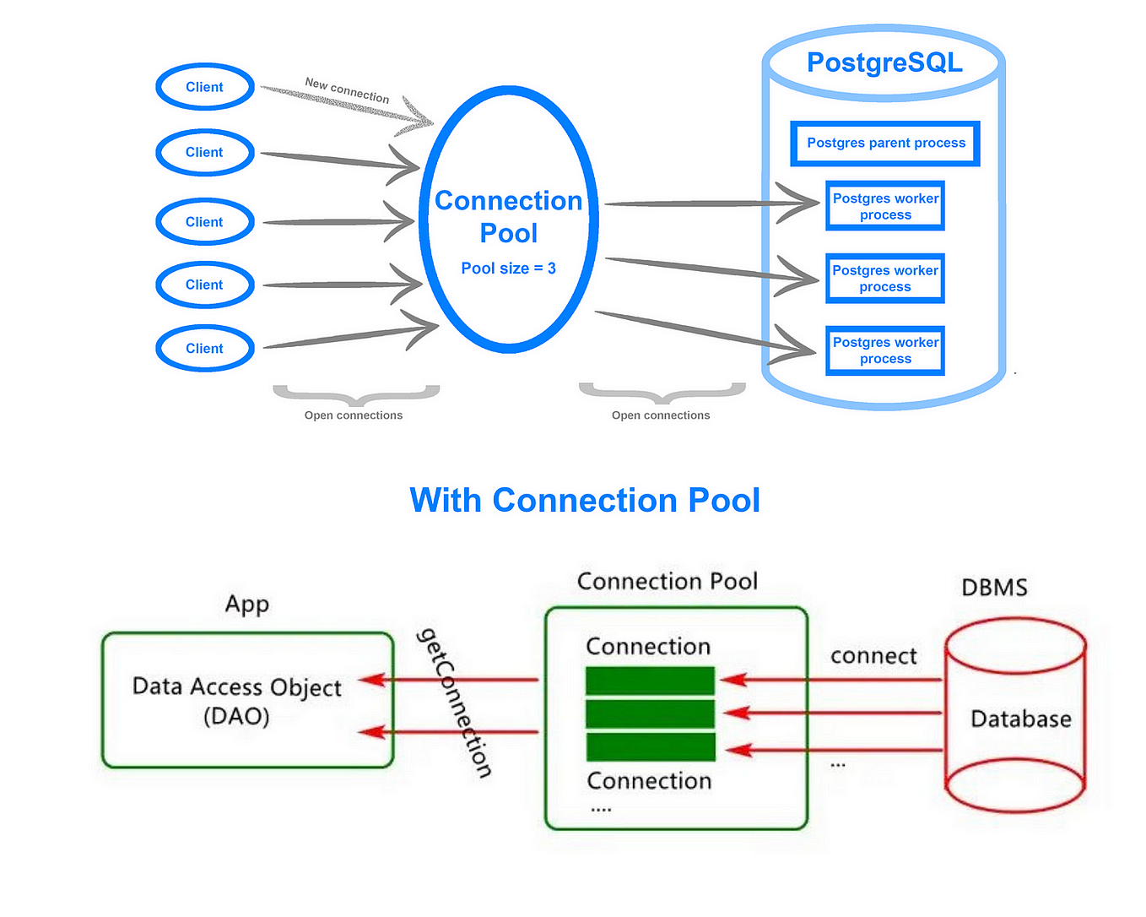
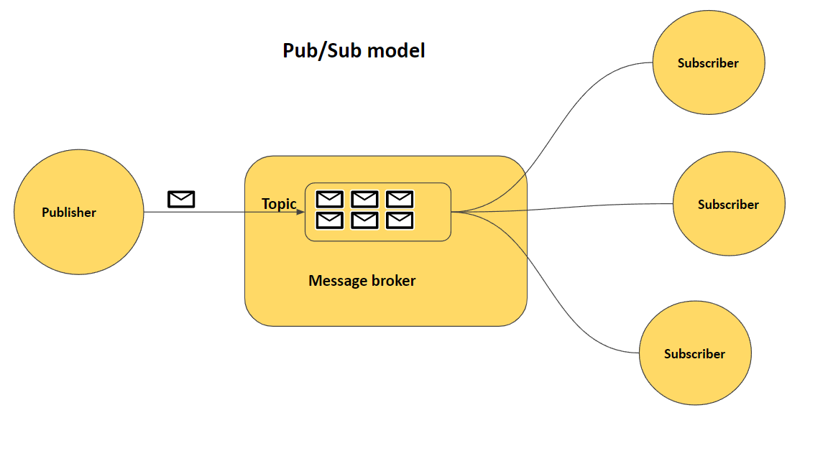
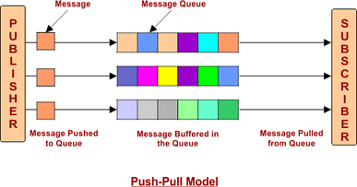
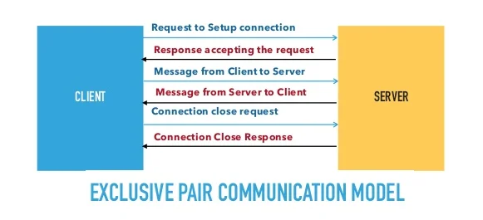
Key Communication Models in IoT
Request-Response model
Publish-Subscribe model
Push-Pull model
Exclusive Pair model
4

Slide 5
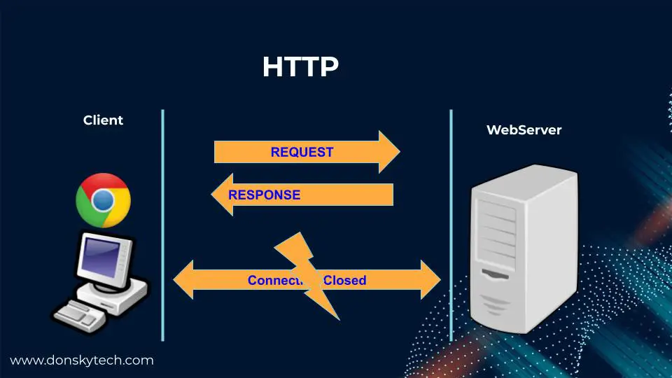
Request-Response model
This model follows a client-server architecture.
The client, when required, requests the information from the server. This request is usually in the encoded format.
This model is stateless since the data between the requests is not retained and each request is independently handled.
5

Slide 6
Request-Response model
Example:
When we search a query on a browser then the browser submits an HTTP request to the server and then the server returns a response to the browser (client).
6

Slide 7
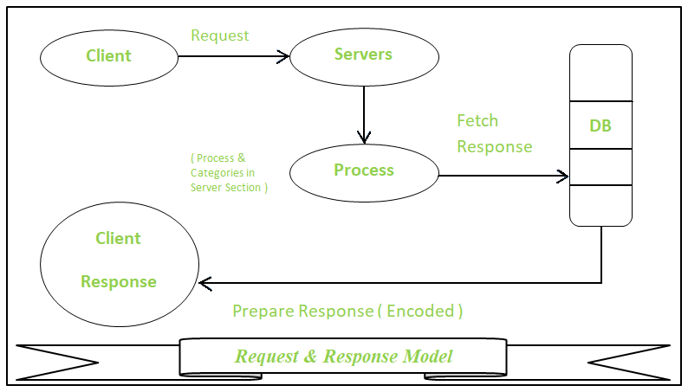
7

Slide 8
Publisher-Subscriber Model
This model comprises three entities:
Publishers
Brokers
Consumers
8

Slide 9
Publisher-Subscriber Model
Publishers are the source of data. It sends the data to the topic which are managed by the broker. They are not aware of consumers.
Consumers subscribe to the topics which are managed by the broker.
Brokers responsibility is to accept data from publishers and send it to the appropriate consumers.
9

Slide 10
Publisher-Subscriber Model
The broker only has the information regarding the consumer to which a particular topic belongs to which the publisher is unaware of.
10

Slide 11
Publisher-Subscriber Model
Example:
On the website many times we subscribed to their newsletters using our email address. These email addresses managed by some third-party services and when a new article published on the website it directly sends to the broker and then the broker send these new data or post to all the subscribers.
11

Slide 12
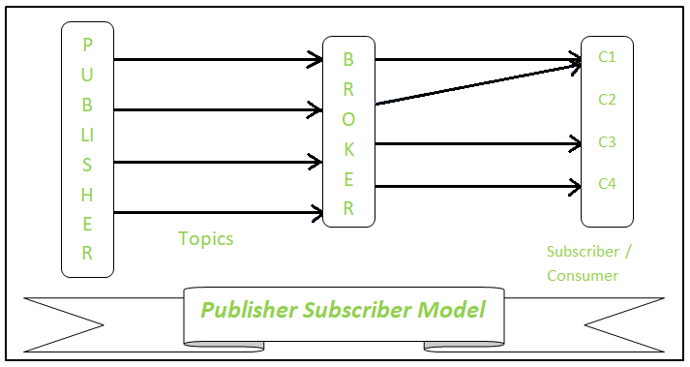
12

Slide 13
Push-Pull Model
The push-pull model constitutes
Data publishers
Data consumers
Data queues.
13

Slide 14
Push-Pull Model
Publishers and Consumers are not aware of each other.
Publishers publish the message/data and push it into the queue. The consumers, present on the other side, pull the data out of the queue.
The queue acts as the buffer for the message when the difference occurs in the rate of push or pull of data on the side of a publisher and consumer.
14

Slide 15
Push-Pull Model
Queues help in decoupling the messaging between the producer and consumer.
Queues also act as a buffer which helps in situations where there is a mismatch between the rate at which the producers push the data and consumers pull the data.
15

Slide 16
Push-Pull Model
Example:
When we visit a website we saw a number of posts that published in a queue and according to our requirements, we click on a post and start reading it.
16

Slide 17
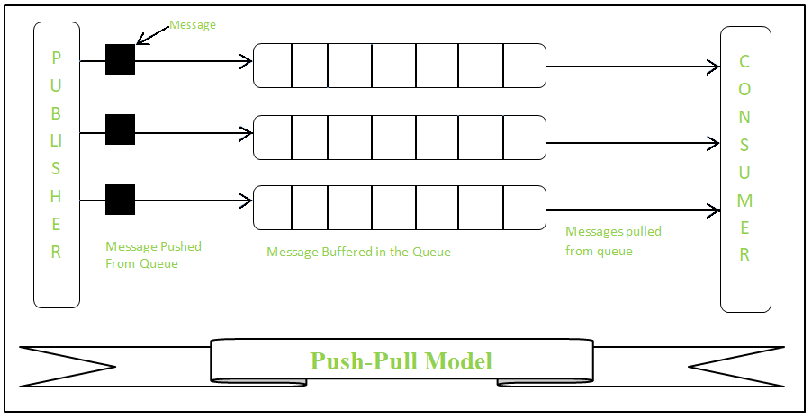
17

Slide 18
Exclusive Pair model
Exclusive Pair is the bi-directional model, including full-duplex communication among client and server.
The connection is constant and remains open till the client sends a request to close the connection.
The Server has the record of all the connections which has been opened.
18

Slide 19
Exclusive Pair model
This is a state-full connection model and the server is aware of all open connections.
WebSocket based communication API is fully based on this model.
19

Slide 20
Exclusive Pair model
Example:
WebSocket based communication API is fully based on this model.
20

Slide 21
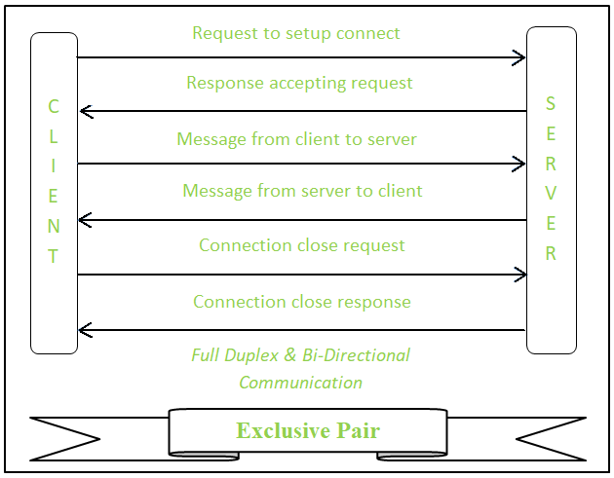
21

Slide 22
Question:
Define and differentiate between the Request-Response and Publish-Subscribe communication models in IoT. Provide examples of their real-world applications.
Discuss the challenges of using the Push-Pull communication model in large-scale IoT networks. How can these challenges be addressed?
22

